Slide 1

A Case Study on

Slide 2
Have you ever questioned the authenticity of a product you purchased?
(Especially the ones that costed you a bomb)

Slide 3
Did you ever wish that you could somehow verify that it’s a genuine product and be at peace?

Slide 4
That is exactly what is trying to solve..

Slide 5
So, what is ?

Slide 6
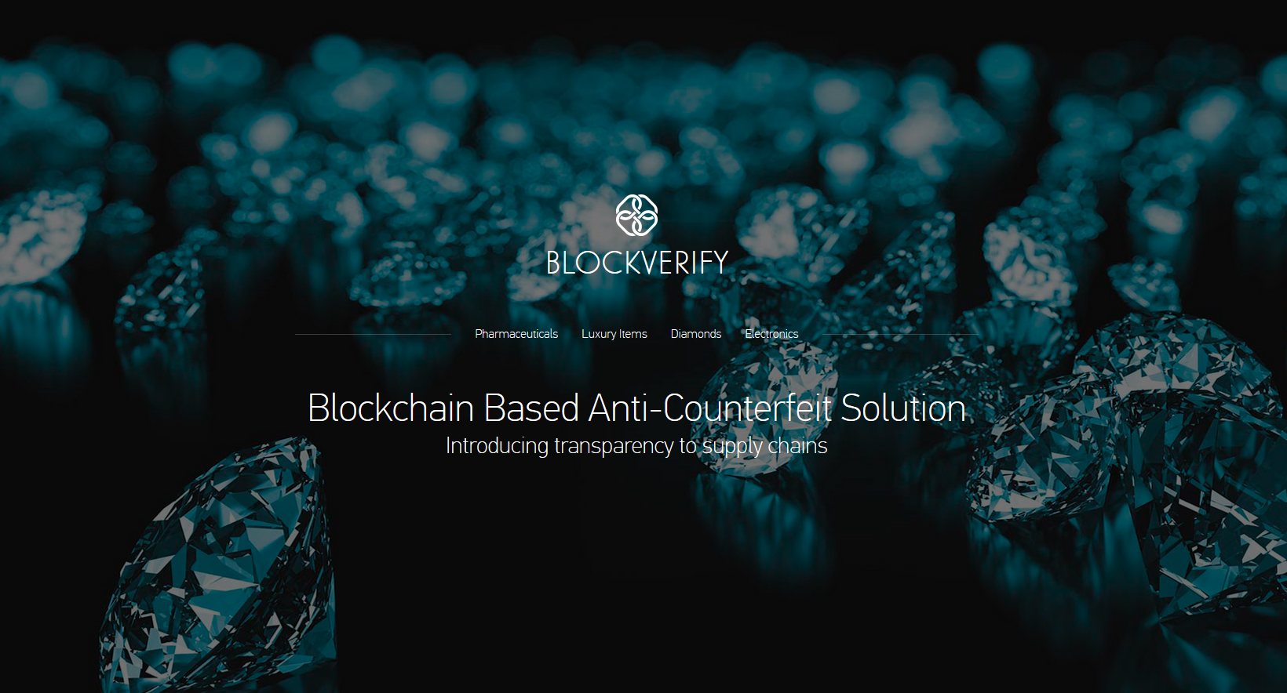

Slide 7
A company founded in 2014 and based in London, UK
Blockverify offers global solutions to identify counterfeits, using Blockchain technology and allows companies themselves to create products and monitor supply chains
They target luxury items, diamonds, electronics as well as the pharmaceutical market.
Improving anti-counterfeit measures can only be achieved by using a decentralized, scalable and tamper-proof solution
Blockverify will make use of a private Blockchain, a highly scalable transparent protocol, in order to assign every manufactured product as an asset

Slide 8
The Problem

Slide 9

As of 2016, the counterfeiting problem was estimated at around
1.7 Trillion US Dollars
This severely
destroys reputation for brands
and
undermines customer loyalty
That is 12,16,28,03,00,00,000 in INR

Slide 10
They are trying to solve the counterfeiting problem mainly in the following industries –
Pharmaceuticals
Luxury Items
Diamonds
Electronics

Slide 11
The number is alarming, as this does not only lead to lost revenue for manufacturers, but also tax losses
Typical products being counterfeited do not only include high-value luxury goods such as designer clothing, footwear, watches and jewellery, but a wide range of more common products
The list can be expanded to consumer electronics, other electrical components, food, drinks, tobacco, agricultural products, toiletry products and pharmaceuticals
In case of pharmaceutical products, the implications are more severe than monetary: counterfeit products might not contain the right active ingredients and therefore can be useless to harmful. Especially in developing countries, people are dying after being treated with fake medicine

Slide 12
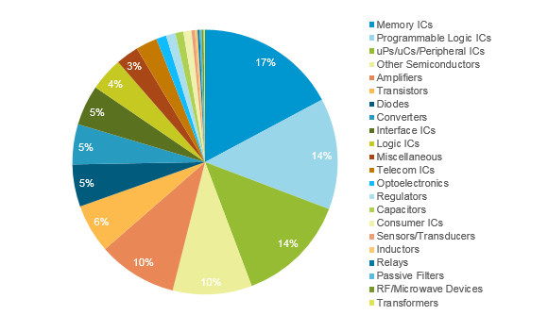

Slide 13
They Can Verify The Following -
Counterfeit Products
A product that is already in possession and is determined to be counterfeit
Diverted Goods
The system is able to identify if a product was diverted from its original destination
Fraudulent Transactions
Block Verify can track fraudulent transactions of any type throughout the system

Slide 14
The Solution

Slide 15
How are they doing this?
Each product which is tracked by Blockverify has a Blockverify tag and is tracked along the supply chain.
Retailers can check that received goods are genuine. Once a product is sold, the consumer can also verify if it’s authentic and activate the ownership of the product
As the transactions are stored in the Blockchain, it cannot be corrupted, even by the manufacturers themselves. Blockverify can provide “verified history” of each product in its system.

Slide 16
They provide a B2B and Consumer application using which you can scan and verify if the product is genuine.
This is achieved by encrypting unique information into 2D Data Matrices and RFID tags which are then embedded onto the product.
The user can scan the tags to get all the information about the product and verify it’s authenticity as well. Information like – The individuals and businesses in the supply chain, the manufacturing date and that no duplicates exist in the supply chain.
This can be done online as well as offline.

Slide 17
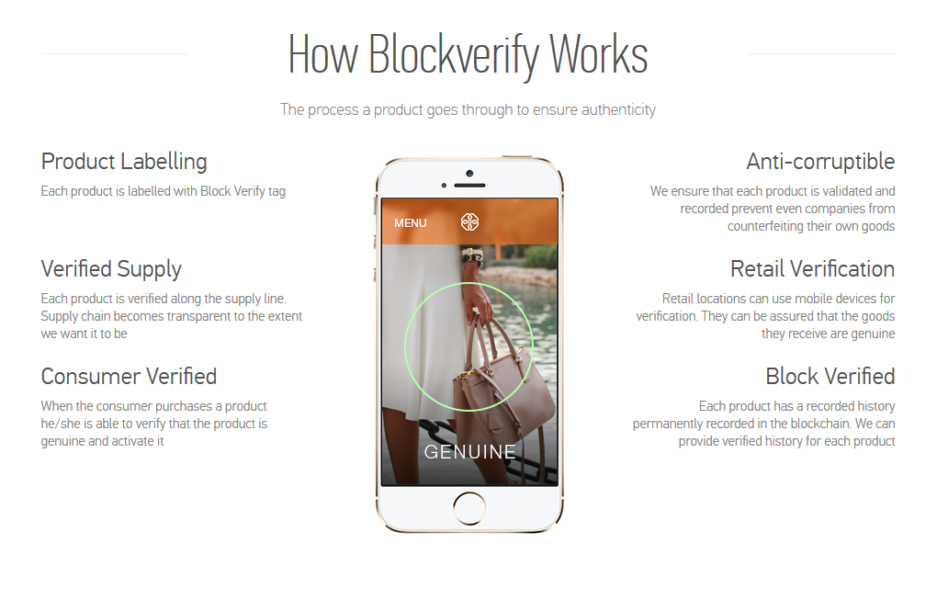

Slide 18
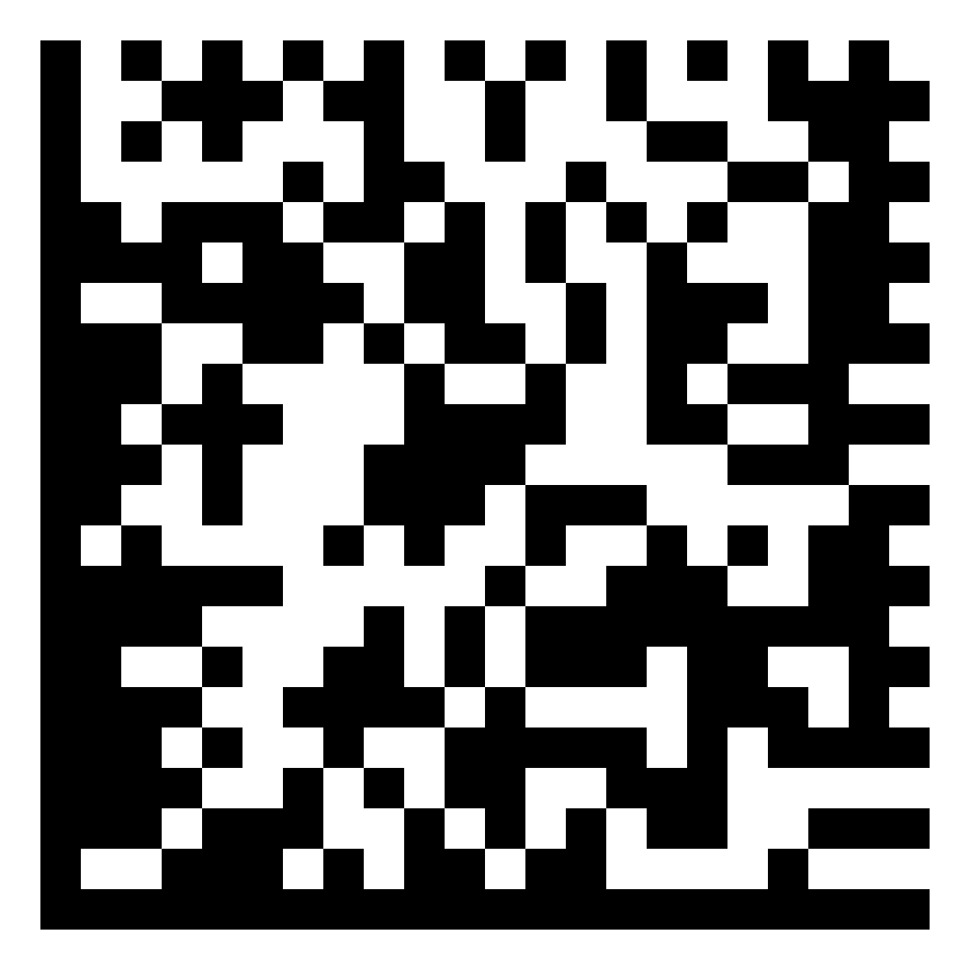
2D Data Matrix
A Data Matrix Code is a two-dimensional (2D) code that consists of black and white modules, usually arranged in a square pattern. As more data is encoded in the symbol, the number of modules (rows and columns) increases.
The alphanumeric data of Data Matrix codes identifies details of the component on which it is placed, including manufacturer ID, part number and a unique serial number.
The most popular application for Data Matrix is marking small items, due to its ability to encode a large amount of data in a small amount of space.

Slide 19
What is encoded into the tags?
Depends on the product type -
For Pharma products there are different standards so based on those it’ll be different
For unique items, we could hash the unique properties of the item and put them on the Blockchain and then take a picture

Slide 20
What Blockchain is it based on?
The Blockchain being used is their own proprietary Blockchain similar to Bitcoin’s
But it uses Proof of Stake instead of Proof of Work
It’s a Permissioned Blockchain meaning it’s not public and only nodes with permission can participate in it
But reading data from it is unrestricted and visible to public

Slide 21
Successful Pilot Program
Blockverify has successfully completed the first part of a pilot program with a Swiss pharmaceutical company with a UK presence.

Slide 22
For more information -
http://www.blockverify.io/
https://www.youtube.com/watch?v=ZqI3IrrVvKc
https://www.merlin.uzh.ch/contributionDocument/download/10024
https://bitcoinist.com/block-verify-turns-bitcoin-life-saving-technology/
https://scm.ncsu.edu/scm-articles/article/how-blockchain-could-impact-counterfeiting-across-the-supply-chain

Slide 23

THANK YOU
By
Rachet Mudnur (INT16IS090)

